Slide 1
Predicting Food Security with Machine Learning
Yujun Zhou, Kathy Baylis, Erin Lentz, Hope Michelson
Agricultural and Consumer Economics
University of Illinois
IPAD Seminar
10/17/2019
Notes:
Varun Kirshagar

Slide 2
Motivation - The Problem
We lack the ability to identify food insecure populations in time to intervene. Humanitarian response tends to trail the onset of food security crises.
Currently use the Integrated Food Security Phase Classification System (IPC).The IPC relies on a convergence of evidence approach rather than a formal model (IPC, 2012)
The IPC has been accused of being too complex, requiring extensive information, and vulnerable to political influence (The Economist, 2017; De Waal, 2018)
Need to have a data-driven, transparent framework to provide accurate, frequent, spatial granular predictions of food security crises

Slide 3
Motivation - The Efforts
Night-lights data to predict village-level poverty (asset index) (Chen and Nordhaus 2011; Henderson et al. 2012), noisy and lack of variation in certain areas
Mobile phone data (Blumenstock et al., 2015; Steele et al., 2017) accurate but hard to scale
Satellite imagery (Engstrom et al., 2017; Donaldson and Storeygard, 2016) - lack of labeled data to extract structured information
Combining night-lights and satellite imagery in a CNN model (up to 70% accuracy) (Jean et al., 2016; Babenko et al. 2017)
Reliance on satellite imagery and Nightlights data (Head et al. 2017)
works in some areas better than others (SSA; Nepal and Haiti are problematic)
does not capture changes in poverty over time
does not do so well with other development metrics: nutrition, health

Slide 4
Motivation - The Opportunity
Recent increase in available data related to food security, geography, weather, and market price for food.
These data are often evaluated in isolation and require a systematic framework of combining data from different sources, frequency and spatial scale.

Slide 5
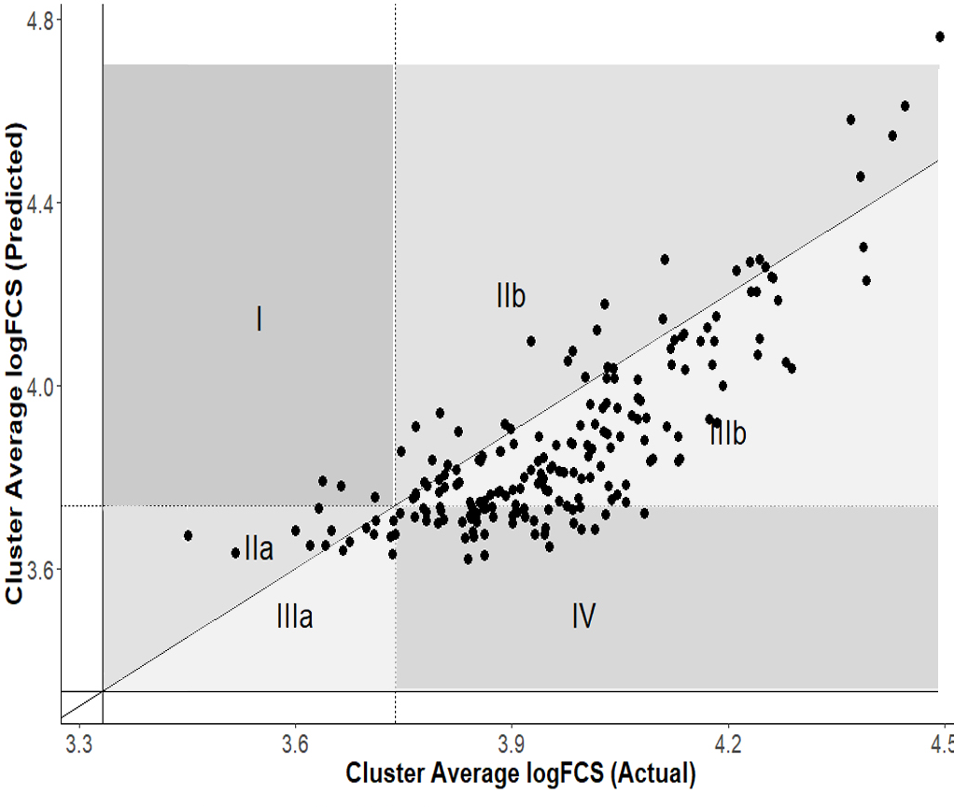

Motivation - The Challenge
Lentz et al. (2019) incorporate these data into a single predictive model of food security early warning
Achieved R squared up to 0.65 and categorical accuracy up to 90%
Predict well among the mean of the data, but not so great on the tails of the distribution

Slide 6
Motivation - The Challenge
Capturing villages that face a potential threat of hunger, i.e. the most food insecure groups
As with any rare event, the low rate of severe food insecurity in the baseline data tend to be ignored by the models
Use machine learning and data techniques to address this imbalance to capture a higher fraction of these rare events.

Slide 7
Detecting Rare but Relevant households
FCS
Food Consumption Score
HDDS
Household Dietary Diversity Scale
rCSI
Reduced Coping Strategy Index
Zhou, Baylis, Lentz, and Michelson

Slide 8
Research Question
Can build an early warning system of food security in areas where data are scarce and data collection is costly? (Hutchinson,1991)
Successfully detect the rare events food insecurity, informing the when and where food shortages tend to happen
A framework that is automatically updated, generalizable, scalable and cost-effective

Slide 9
Summary
Build ML models to predict cluster-level food security status for targeting, aid purposes in times of food shortage
Use LSMS data for Malawi, Tanzania and Uganda as ground truth
Use market price of food staples, weather shocks in growing seasons, and geospatial features around clusters to predict potential food security challenges
Use data techniques (sampling, cross-validation, data segmentation) to improve prediction performance
Correctly categorize 63-84 % of food insecurity categories and up to 20-57% of the most food insecure categories
We find assets, roof types, price variables, and weather shocks play a big role in prediction

Slide 10
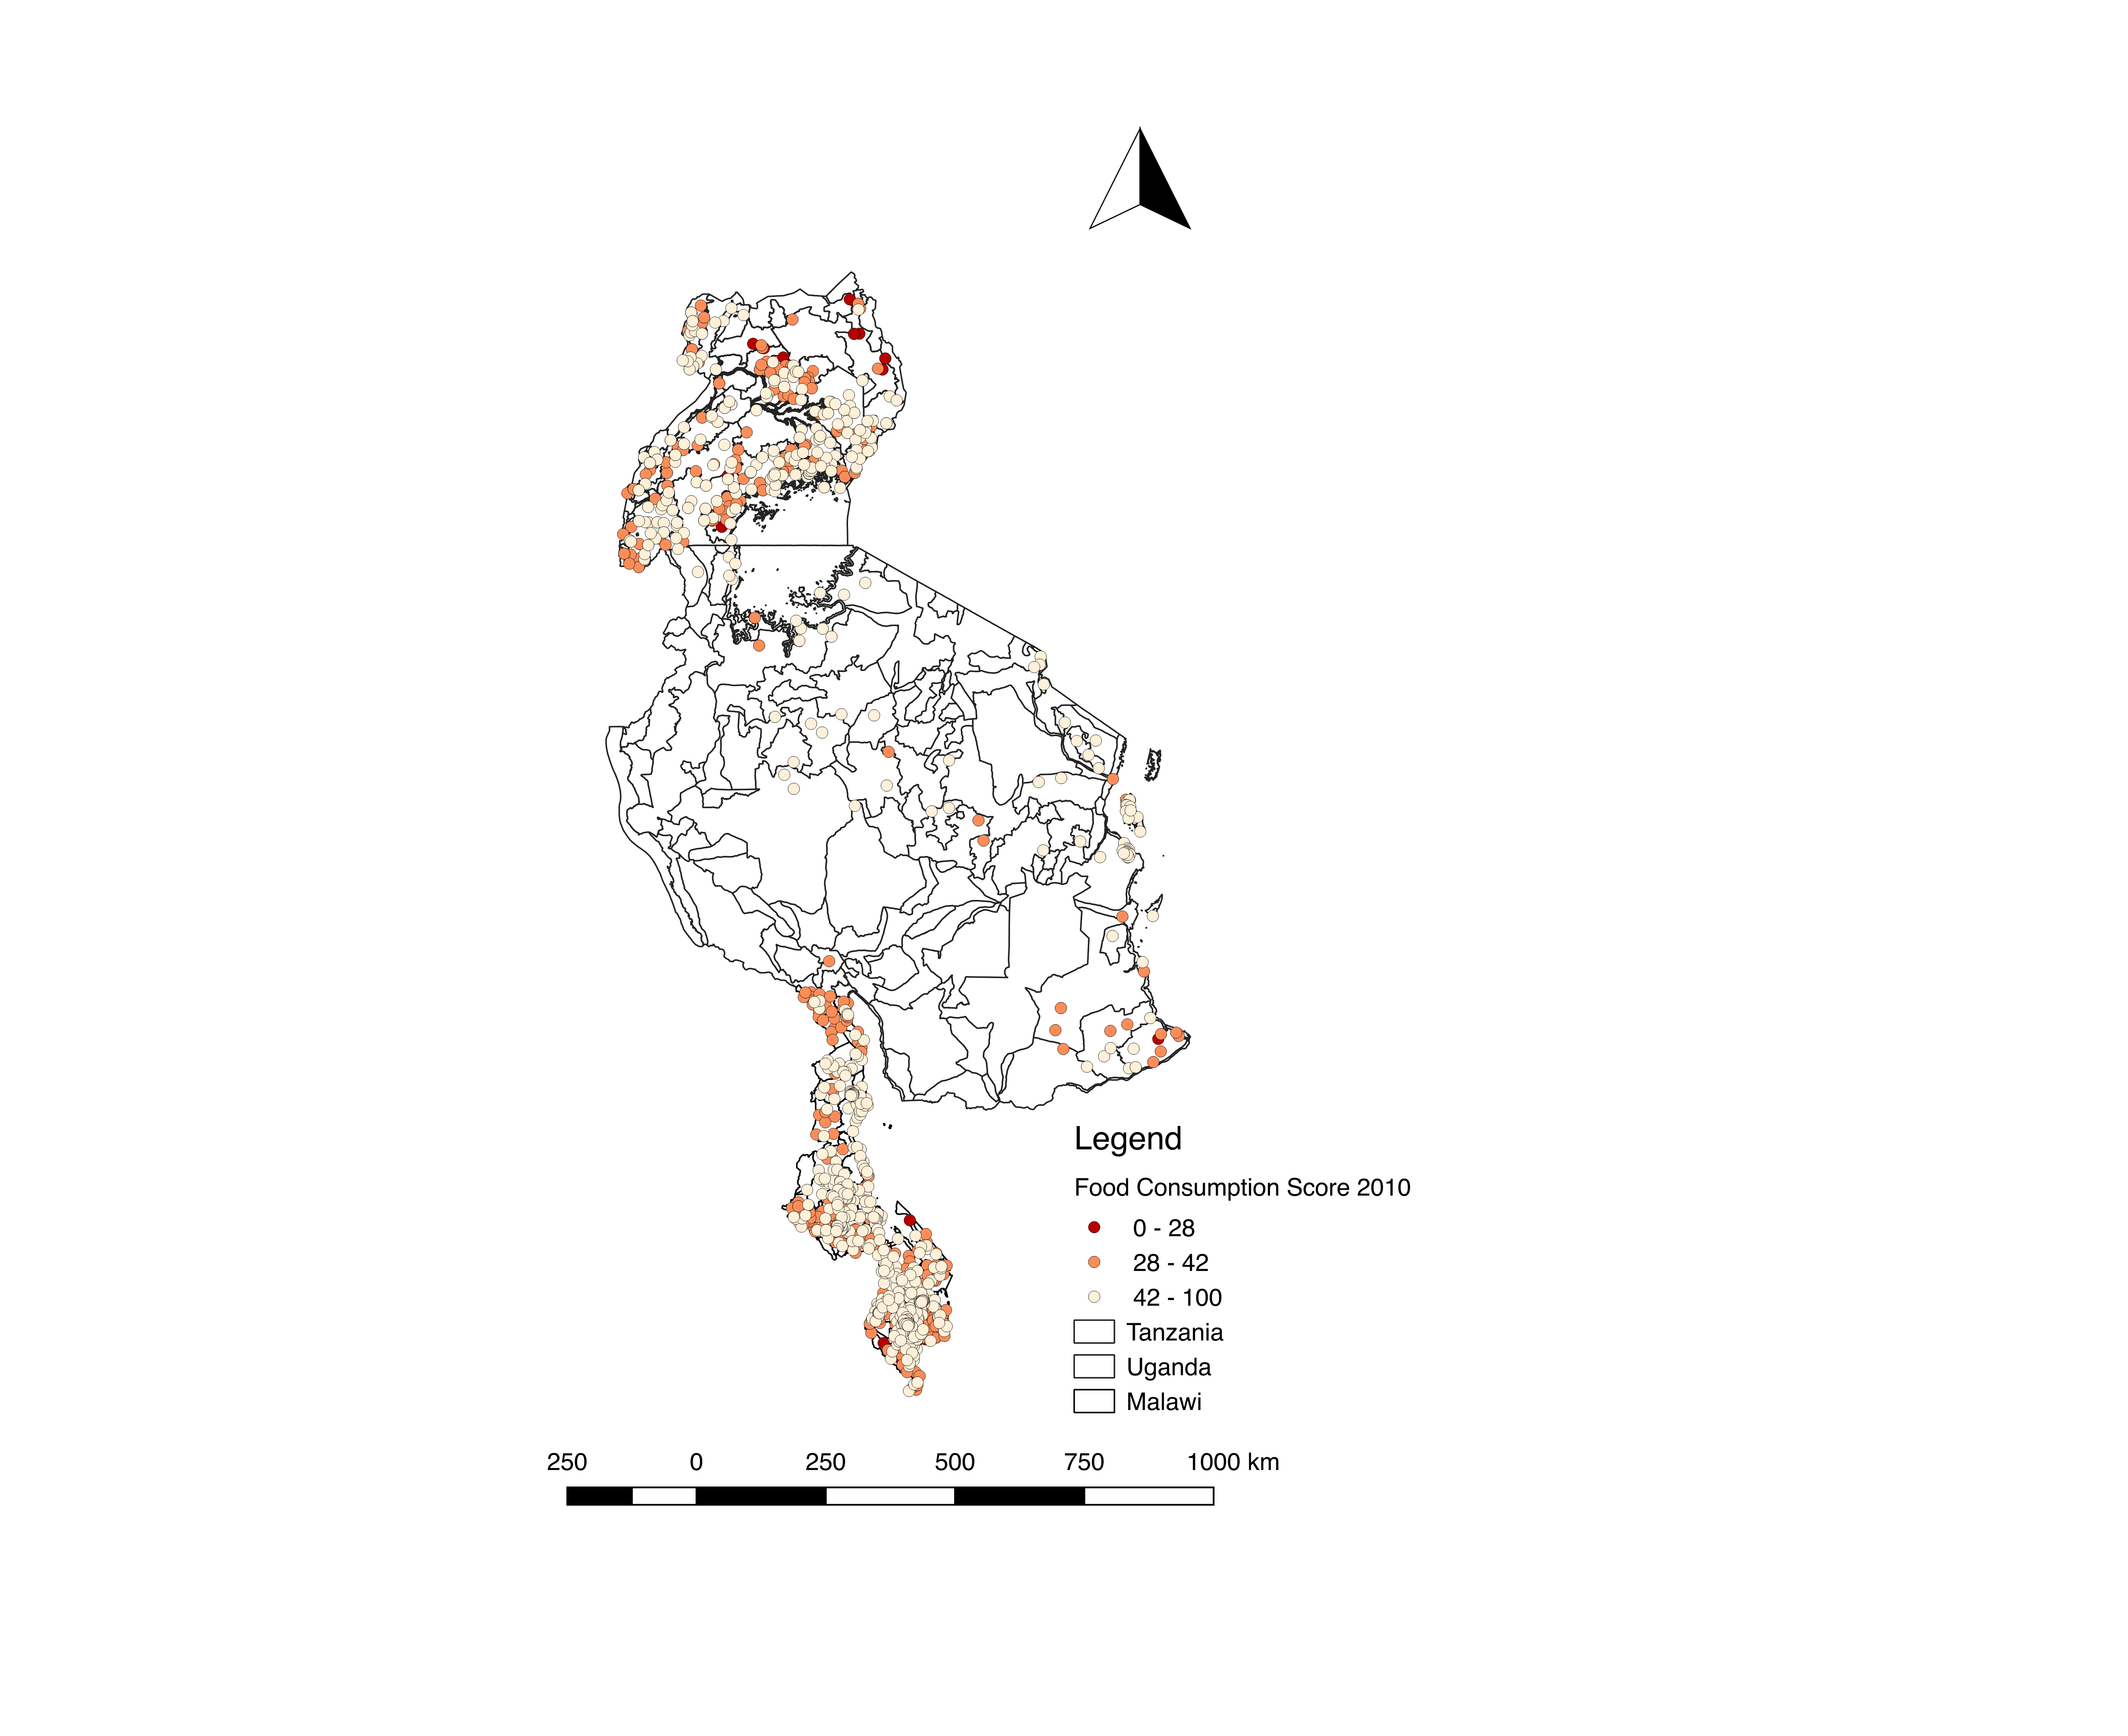
Data
LSMS
survey
Ground truth data in Uganda/Tanzania/Malawi
Household assets, demographics, geolocation of clusters
Prices
Major grain prices (maize, rice, nuts, beans etc.) in main agricultural markets prices, collectedly monthly
Lagged one month before the survey time
Weather
Precipitation/temperature from remote sensing are relevant to agricultural production
From the previous growing season
Three different rounds each with broad spatial coverage
Distance to roads and markets reflects access to market and information
Zhou, Baylis, Lentz, and Michelson

Slide 11
Framework
Public data
Features
Location
Data
Processing
Data techniques
Modelling
Evaluation
HH surveys
Weather
Prices
Roof /Assets
Data
Collection
Satellite images
Roof/Asset
Dry spells
Maize price
Labels
Dist/Soil
Data Split
Categorical
Data Seg.
year
Binary
ROC
FEWs
Recall/F-1
Data Sampling
ML
Error analysis
Importance
Deploy
SMOTE

Slide 12
Decisions, decisions
Categorical versus continuous prediction
If categorical, how do we address rare events?
How do we split the data?
What algorithm do we use?
Zhou, Baylis, Lentz, and Michelson

Slide 13
Categorical vs Continuous?
Focus on the categorical prediction for the given cutoffs of each food security measures.
Recall rate of the insecure villages is more important than the over all accuracy.
Typically, classifiers are more sensitive to detecting the majority class and less sensitive to the minority class.
Close to the actual policy scenarios where policy makers need to locate places with most insecure households.
Apply the down sampling, over sampling, and synthetic data techniques to force the model to learn about the tail of the distribution
Zhou, Baylis, Lentz, and Michelson

Slide 14
Detecting Rare but Relevant households
FCS
Food Consumption Score
rCSI
Reduced Coping Strategy Index
Zhou, Baylis, Lentz, and Michelson

Slide 15
Methodology: Under sampling, Over sampling and Synthetic data
Zhou, Baylis, Lentz, and Michelson
Notes:
SMOTE is an over-sampling method. What it does is, it creates synthetic (not duplicate) samples of the minority class. Hence making the minority class equal to the majority class. SMOTE does this by selecting similar records and altering that record one column at a time by a random amount within the difference to the neighbouring records.

Slide 16
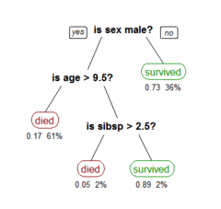
Methodology: Classification Algorithms
For structured data like ours (unlike text or pure image), tree-based methods are popular (Weiss, 2014; Tischio and Weiss 2019)
Classification Tree (base learner)
Random Forest ( parallel )
Gradient Boosting (sequential)
Zhou, Baylis, Lentz, and Michelson

Slide 17
Recall (are we getting all the insecure households ?)
Precision (are we mistakenly categorizing secure households as insecure?)
F-1 score (balance recall and precision)
Overall categorical accuracy
Methodology: Result Measurements
Zhou, Baylis, Lentz, and Michelson

Slide 18
Compare to baseline Model
Logistic Regression
Data split: year split (cross-validated)
Data segmentation: by country
Down/over sampling: None
Variable groups:
Asset: cellphone ownership, floor/roof material, asset index
Location: elevation, distance to road, urban/rural
Market : food price, market thinness
Weather: dry spells, average temperature and rain
Zhou, Baylis, Lentz, and Michelson

Slide 19
Methodology: Cross-validation
Rare events of food insecurity tend to vary a lot year by year, i.e. 1 or 2 cases in a good year vs over 50 cases in a bad year
Use any two years as training data to predict the third year
Average out the performance after cross-validation to get more stable and trustworthy result
Zhou, Baylis, Lentz, and Michelson

Slide 20
Binary cutoff (safe vs not)
Receiver Operating Characteristic (ROC) curve
Compared to three/four category cutoffs:
Coarser classification of clusters that may require assistance
ROC curve to demonstrate the models’ ability to classify the unsafe category accurately
more data in the minority class to make the models work better
The curve plots the true positive rate (TPR) or recall against the false positive rate (FPR) at different values of threshold, where the threshold is defined as the probability cutoff of treating an instance as 1.
The false-positive rate measures the cases we have a “false alarm.”
The area under the ROC curve (AUC) is a universal statistic for model comparison in the machine learning practices.
Zhou, Baylis, Lentz, and Michelson

Slide 21
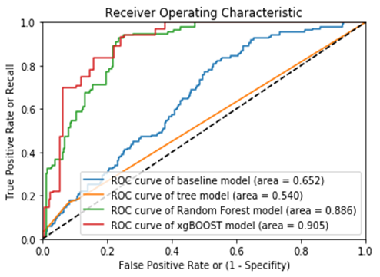
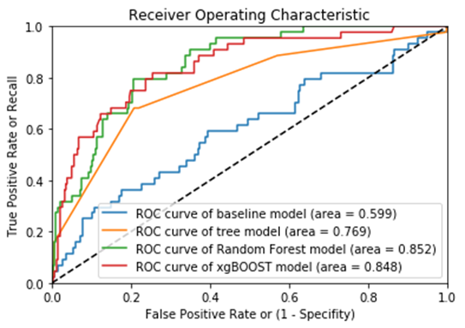
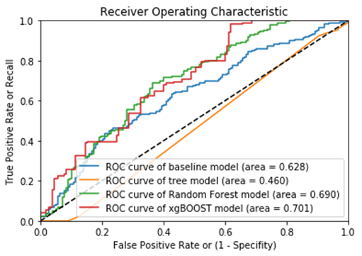
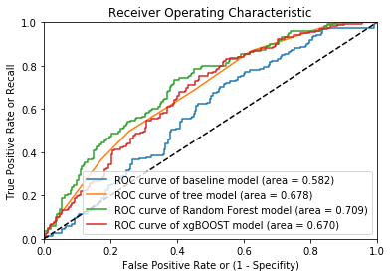
Results for binary cut-off
FCS
Malawi
Tanzania
rCSI
Notes:
Receiver Operating Characteristic (ROC) curve
The curve plots the true positive rate (TPR) or recall against the false positive rate (FPR) at different values of threshold, where the threshold is defined as the probability cutoff of treating an instance as 1.
The false-positive rate measures the cases we have a “false alarm.”
The area under the ROC curve (AUC) is a universal statistic for model comparison in the machine learning practices.

Slide 22
In table format… Binary Baseline vs ML algorithms, no oversampling (year split) Similar accuracy, higher recall
Country | Food Security Measure | Overall Accuracy (baseline) | Overall Accuracy (ML) | Recall Rate Insecure category (baseline) | Recall Rate Insecure category (ML)
Malawi 2010/11, 2013 to predict 2015/16 | FCS | 0.71 | 0.75-0.76 | 0.26 | 0.18-0.38
 | rCSI | 0.69 | 0.60-0.63 | 0.36 | 0.54-0.72
Tanzania 2010/11, 2012/13 to predict 2014/15 | FCS | 0.81 | 0.82-0.84 | 0.06 | 0.08-0.29
 | rCSI | 0.55 | 0.59-0.63 | 0.29 | 0.43-0.54
Uganda 2010,2011 to predict 2012 | FCS | 0.67 | 0.59-0.71 | 0.36 | 0.33-0.36
Notes:
RF tends to have the highest recall

Slide 23
Table 2: Baseline vs ML algorithms with down/over sample technique
Country | Food Security Measure | Recall Rate Insecure category (Baseline) | Recall Rate Insecure category ML + Oversample | Recall Rate Insecure category ML + SMOTE-TOMEK | Recall Rate Insecure category ML + ADASYN
Malawi | FCS | 0.27 / 0.00 | 0.30 / 0.27 | 0.33 / 0.06 | 0.53 /0.15
 | rCSI | 0.36 / 0.00 | 0.33 / 0.00 | 0.42 / 0.20 | 0.46 / 0.20
Tanzania | FCS | 0.01 / 0.00 | 0.08 / 0.00 | 0.22 / 0.01 | 0.23 / 0.43
 | rCSI | 0.32 / 0.00 | 0.41 / 0.00 | 0.44 / 0.20 | 0.47 / 0.06
Uganda | FCS | 0.18 / 0.37 | 0.21 / 0.00 | 0.26 / 0.57 | 0.20 / 0.50
Notes:
Interestingly – some of the best fit is with the tree+ADASYN
RF + oversampling also performs well

Slide 24
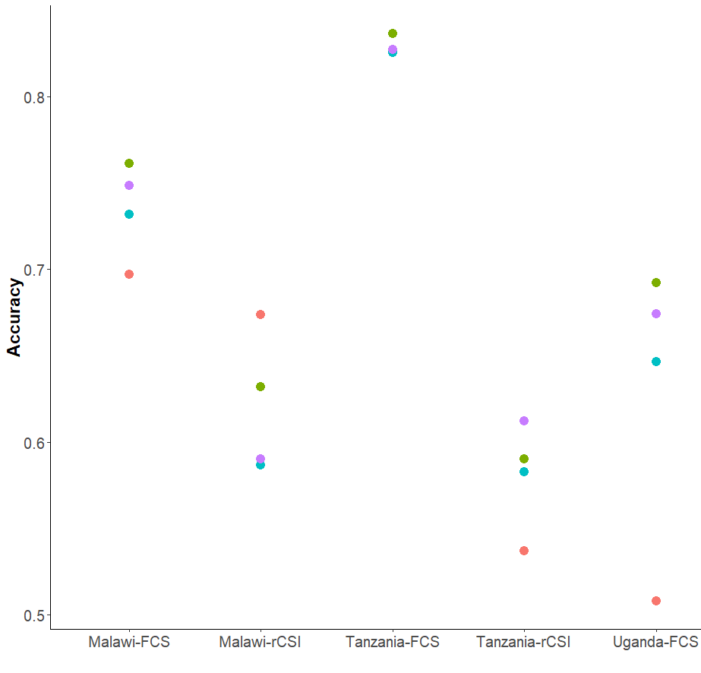
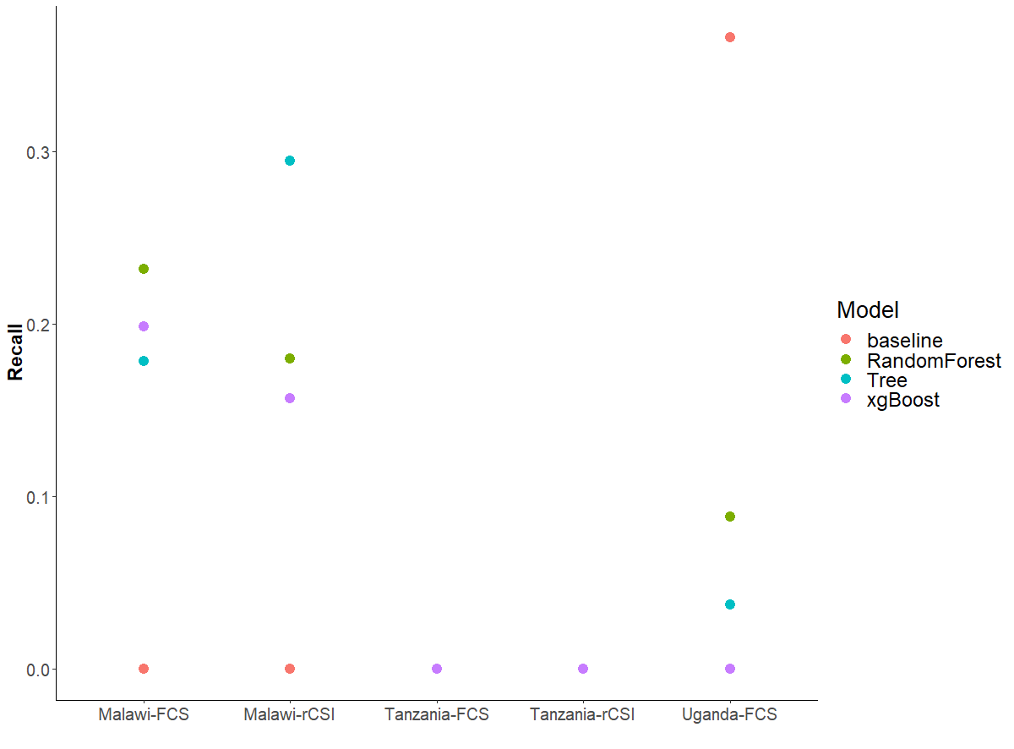
Baseline vs ML algorithms (year split)
Notes:
Need to have a column on overall splits

Slide 25
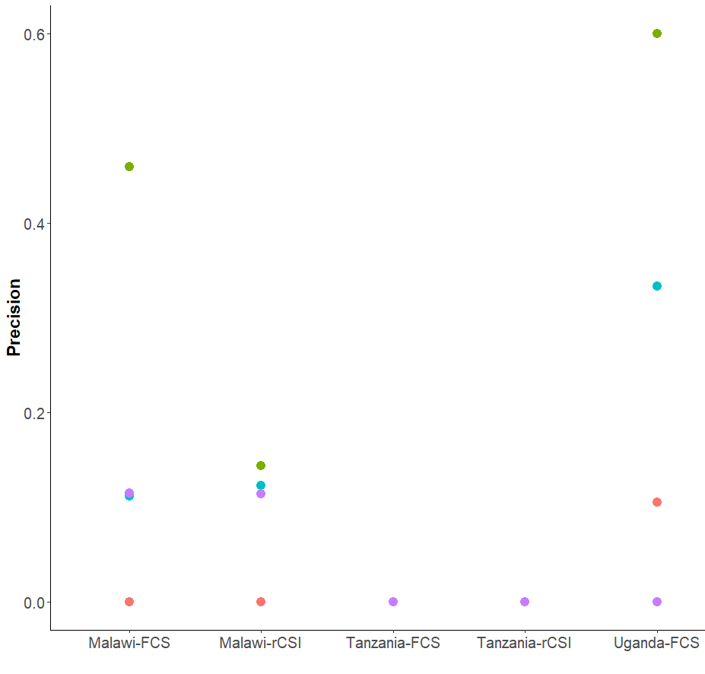
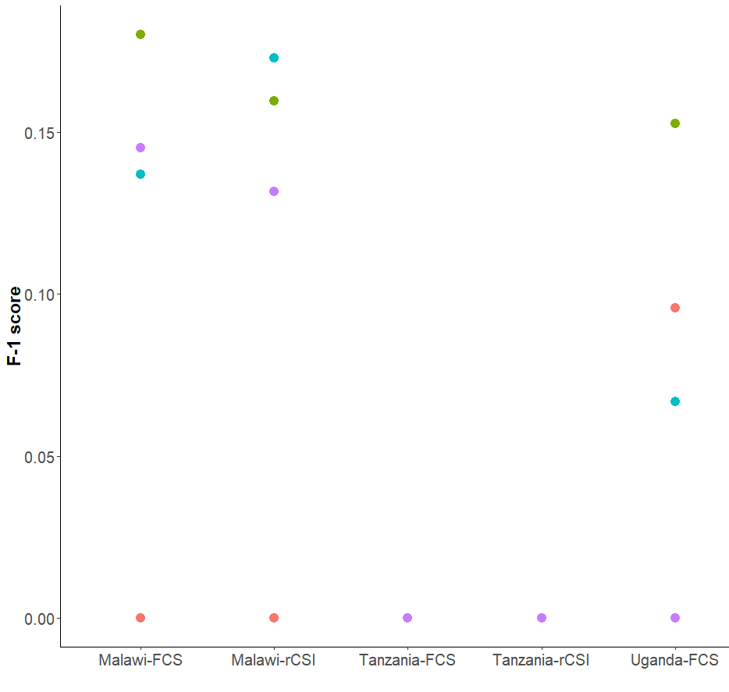

Slide 26
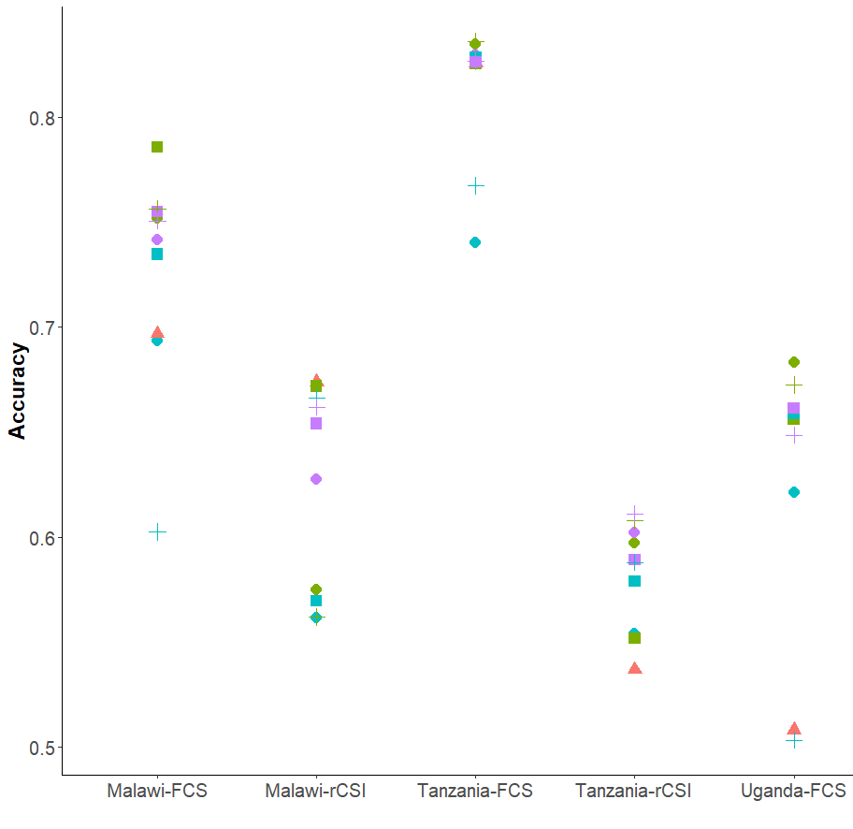
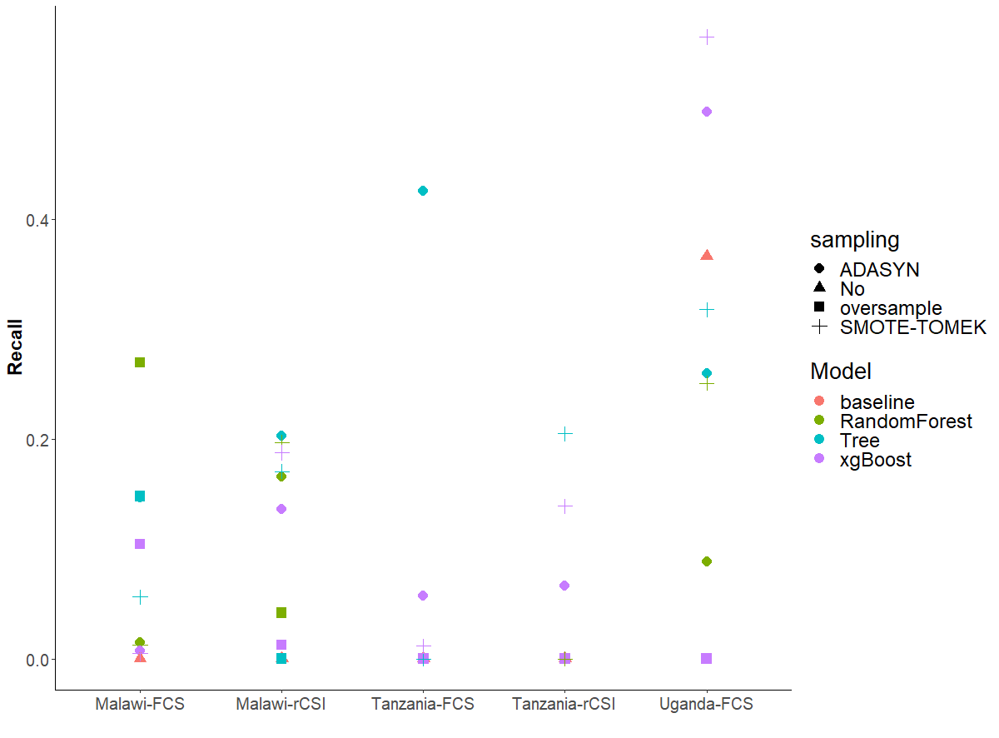
Baseline vs ML algorithms with down/over sample technique

Slide 27
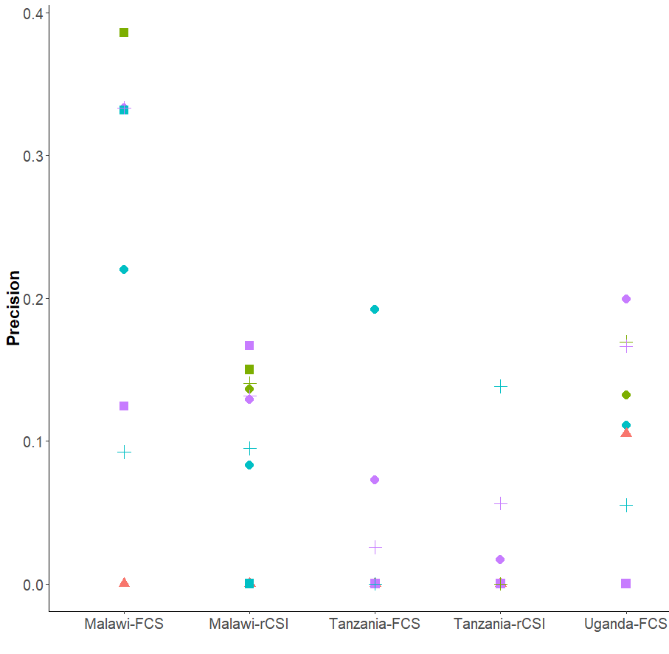
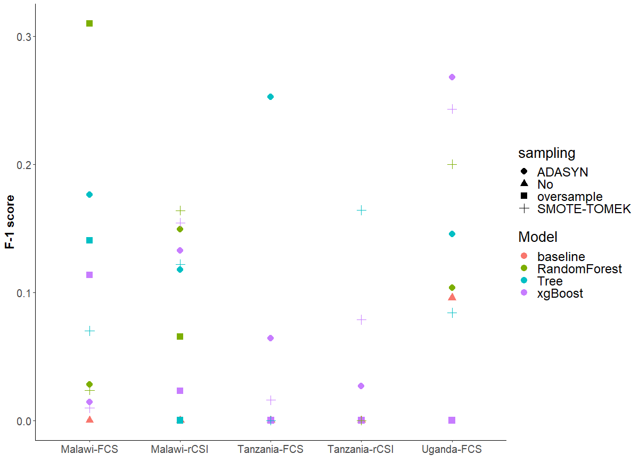

Slide 28
For most severe food security category with oversampling
Country | Food Security Measure | Overall Accuracy (baseline) | Overall Accuracy (ML) | Recall Rate Insecure category (baseline) | Recall Rate Insecure category (ML)
Malawi | FCS | 0.70 | 0.69-0.75 | 0.00 | 0.01-0.27
 | rCSI | 0.67 | 0.58-0.63 | 0.00 | 0.00-0.20
Tanzania | FCS | 0.83 | 0.74-0.84 | 0.00 | 0.00-0.40
 | rCSI | 0.54 | 0.55-0.60 | 0.00 | 0.00-0.52
Uganda | FCS | 0.51 | 0.62-0.68 | 0.37 | 0.00-0.57
Notes:
Interestingly – some of the best fit is with the tree+ADASYN
RF + oversampling also performs well

Slide 29
Feature importance
Cellphone <0.53？
Mean temp
< 24.6 ？
Natural Roof percent<0.3?
Distance to admarc road< 2km？
Asset index< -0.058?
Bean price < 47.43?
Cellphone <0.53？
Mean temp
< 24.6 ？
Natural Roof percent<0.3?
Total rain <779？
Floodmax rain < 832.6?
Bean price < 47.43?
Original
Oversample
Zhou, Baylis, Lentz, and Michelson

Slide 30
Random Forest Feature Importance
Variable | Importance | Std
number_celphones | 0.12 | 0.11
cell_phone | 0.09 | 0.10
roof_natural | 0.05 | 0.06
asset_index | 0.04 | 0.03
FS_month | 0.04 | 0.02
floor_dirt_sand_dung | 0.03 | 0.06
dist_popcenter | 0.03 | 0.02
dist_road | 0.03 | 0.02
percent_ag | 0.03 | 0.02
maxdaysnorain | 0.03 | 0.02
lhz_beans_price | 0.03 | 0.02
dist_admarc | 0.03 | 0.02
floodmax | 0.02 | 0.02
clust_maize_mktthin | 0.02 | 0.02
Variable | Importance | Std
roof_natural | 0.11 | 0.07
cell_phone | 0.09 | 0.10
floor_dirt_sand_dung | 0.08 | 0.04
number_celphones | 0.05 | 0.10
roof_iron | 0.04 | 0.06
day1rain | 0.04 | 0.01
clust_beans_price | 0.04 | 0.01
lhz_maxdaysnorain | 0.03 | 0.02
lhz_nuts_mktthin | 0.03 | 0.01
asset_index | 0.03 | 0.02
household_head_age | 0.03 | 0.02
clust_maize_price | 0.03 | 0.02
dist_road | 0.03 | 0.02
Original
Oversample
Zhou, Baylis, Lentz, and Michelson

Slide 31
XGBOOST Feature Importance
Variable | Importance
roof_natural | 0.11
cell_phone | 0.09
floor_dirt_sand_dung | 0.08
number_celphones | 0.05
roof_iron | 0.04
day1rain | 0.04
clust_beans_price | 0.04
lhz_maxdaysnorain | 0.03
lhz_nuts_mktthin | 0.03
asset_index | 0.03
Household_head_age | 0.03
clust_maize_price | 0.03
dist_road | 0.03
clust_maize_mktthin | 0.02
Variable | Importance
Cellphone | 0.11
num_cell | 0.09
floor_dirt_sand_dung | 0.07
roof_iron | 0.06
asset_index | 0.06
dist_popcenter | 0.06
lhz_day1rain | 0.06
lhz_maize_price | 0.06
dist_road | 0.06
Household_head_age | 0.05
region19 | 0.05
percent_ag | 0.05
region9 | 0.05
Variable | Importance
num_cellphones | 0.15
roof_iron | 0.15
region3 | 0.15
dist_road | 0.12
floor_dirt_sand_dung | 0.12
roof_natural | 0.12
Cellphone | 0.12
floodmax | 0.08
Malawi
Tanzania
Uganda
Zhou, Baylis, Lentz, and Michelson

Slide 32
Methodology: Data Split
Split by year, by region or random
For different application purposes and different data structures
Zhou, Baylis, Lentz, and Michelson

Slide 33
Methodology: Data Segmentation
By country
Entire dataset of three countries
By urban and rural
4. Auto-segmentation by training a shallow tree in each country based on observables
Original data set
By Country
Malawi
Tanzania
Uganda
Original data set
Tree
Node 1
Node 2
Node 3
Node 4
Zhou, Baylis, Lentz, and Michelson

Slide 34
Ongoing work
Price variable selection: which crop, where, and when
Asset/roof variable prediction from satellite imagery
Spatial-temporal correlation on data split
Continuous approach: count of insecure HH for each cluster
Future Steps:
Model generalization: What happens when we directly apply models trained on one country/region to predict another
Model deploy and update: Compare the results of using one year, with a dynamic process of constantly updating model with new survey data
Prediction at “grid” level where satellite imagery available
Zhou, Baylis, Lentz, and Michelson

Slide 35
Conclusions
Combined with data techniques, machine learning methods not only improve prediction accuracy in general, but particularly on households that are vulnerable to food price shocks.
An automated, updated and scalable food security system based on publicly available data, advanced data techniques can assist the work of food aid and humanitarian responses in a timely, transparent, and efficient fashion.
Zhou, Baylis, Lentz, and Michelson

Slide 36
Thank you !
Zhou, Baylis, Lentz, and Michelson

